Slide 1

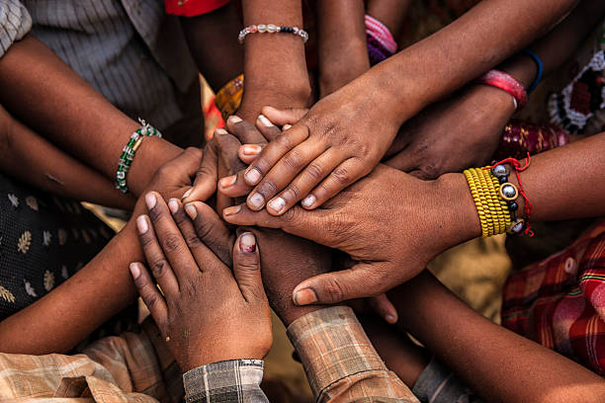





Hope Haven Organization
About Us
Register
Login
The Smallest Act Of Kindness Is Worth More Than The Greatest Intention.
Copyright 2024

Slide 2

Hope Haven Organization
The Smallest Act Of Kindness Is Worth More Than The Greatest Intention.
Login
REGISTERING PAGE
First Name:
Last Name:
Email:
Confirm Email:
Password:
Confirm Password:
REGISTER

Slide 3

WELCOME
Username
Password
Forgot Password?
LOGIN

Slide 4
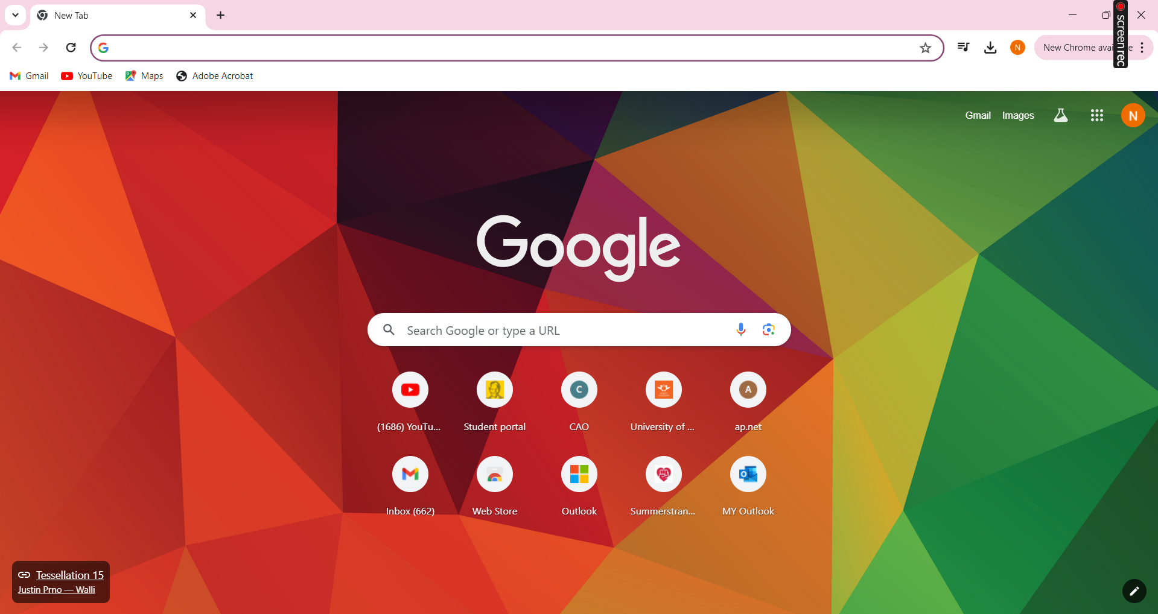

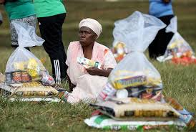
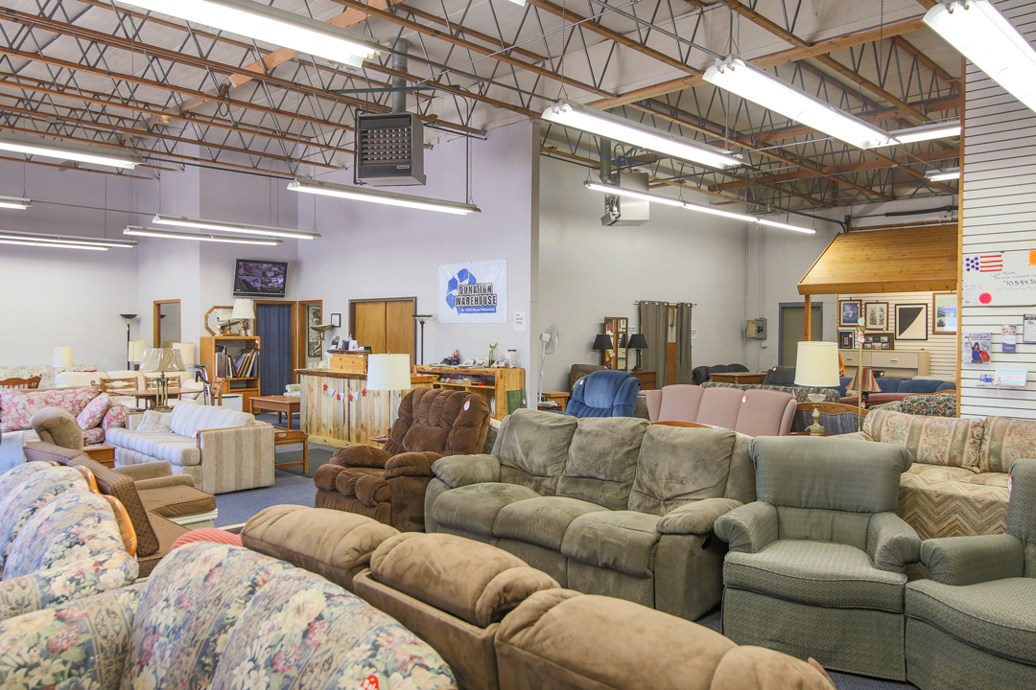





Hope Haven Organization
The Smallest Act Of Kindness Is Worth More Than The Greatest Intention.
Log out
DONATE FOOD
DONATE FURNITURE
DONATE CLOTHES
DONATE ANYTHING
Copyright 2024

Slide 5
Hope Haven Organization
The Smallest Act Of Kindness Is Worth More Than The Greatest Intention.
Log out
DONATING FOOD
Names:
(Optional)
Organisation:
Food Type:
Select delivery Option:
Delivery
Pickup
Place of Collection:
Date & Time:
DONATE NOW

Slide 6
Hope Haven Organization
The Smallest Act Of Kindness Is Worth More Than The Greatest Intention.
Log out
DONATING FURNITURE
Names:
(Optional)
Organisation:
Furniture Type:
Select delivery Option:
Delivery
Pickup
Place of Collection:
Date & Time:
DONATE NOW

Slide 7
Hope Haven Organization
The Smallest Act Of Kindness Is Worth More Than The Greatest Intention.
Log out
DONATING CLOTHES
Names:
(Optional)
Organisation:
Clothes Type:
Size:
Select delivery Option:
Delivery
Pickup
Place of Collection:
Date & Time:
DONATE NOW

Slide 8
Hope Haven Organization
The Smallest Act Of Kindness Is Worth More Than The Greatest Intention.
Log out
DONATING ANYTHING
Names:
(Optional)
Organisation:
Food Type:
Select delivery Option:
Delivery
Pickup
Place of Collection:
Date & Time:
DONATE NOW

Slide 9
Hope Haven Organization
The Smallest Act Of Kindness Is Worth More Than The Greatest Intention.
Log out

Slide 10
Hope Haven Organization
The Smallest Act Of Kindness Is Worth More Than The Greatest Intention.
Log out

